Slide 1
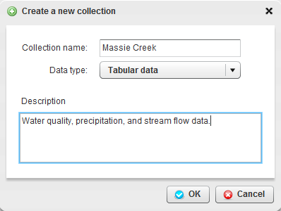
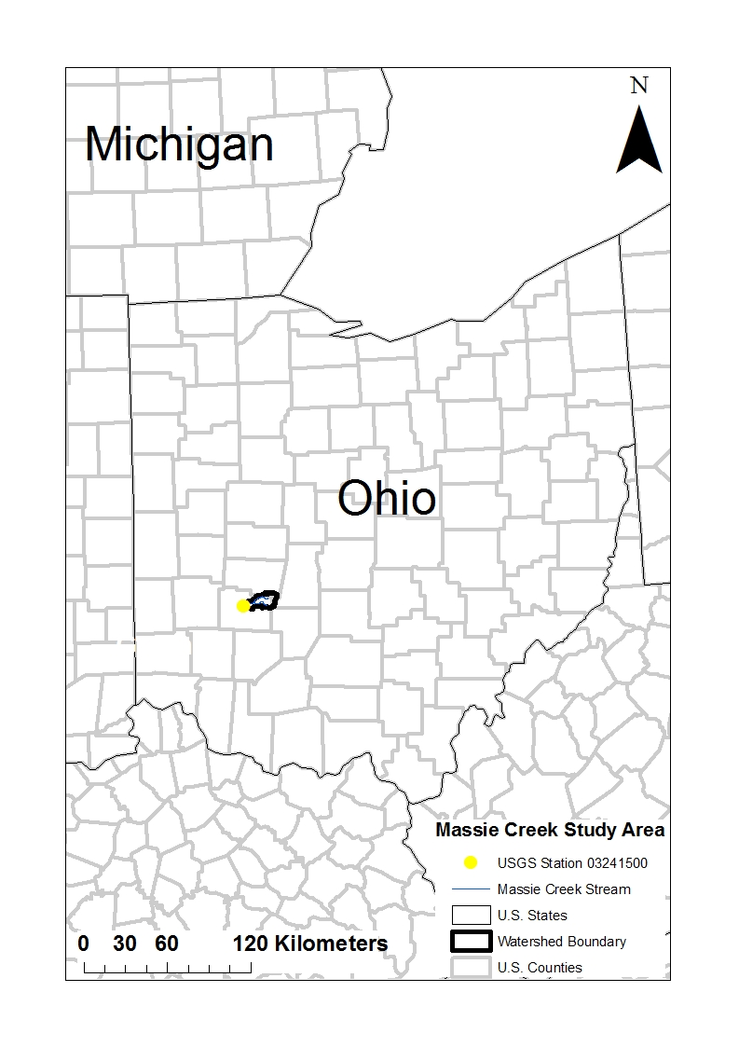
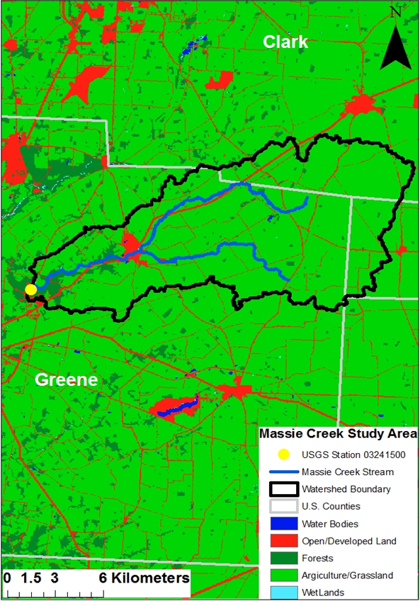
Effects of Drought on Water Quality in Streams
Rashad Riley¹, Xiangning Huang², Jaewoo Lee³, Ganeshchandra Mallya², K.V. Nedunuri¹, Lan Zhao³, Indrajeet Chaubey⁴
¹International Center for Water Resources Management, Central State University ²School of Civil Engineering, Purdue University
³Rosen Centre for Advanced Computing, Purdue University ⁴Agricultural and Biological Engineering, Purdue University
Abstract
iData : driNET tool for uploading data
Results - contd.
The objective of this research is to understand the relationship between low stream flows during droughts and their impact on water quality. The area chosen for this study is the Cedarville sub-watershed that drains into Massie Creek, a tributary to the Little Miami River, Ohio. By using stream flow and water quality data collected from the Massie Creek in Ohio, we will be able to study the impact of droughts on water quality.
The figure on the left shows the iData interface to upload either a file collection or tabular datasets. The flow chart below shows the different steps needed for uploading tabular data.
Time series graph
of water quality parameters, stream flow and precipitation at a daily time-step.
Study Area
File Collection
Add
Giving Name
Date Type
Tabular Data
Determine
Columns
File Folder
Separate Data
Verify Name
Share
Preliminary Results
The geographical location of the Massie Creek sub-watershed in Ohio is shown on the left hand side. The figure on the right shows the land use in Massie Creek watershed, the Little Miami River, and the USGS station at Massie Creek Wilberforce, OH.
Analysis of annual maximum stream flow series shows no significant trends over time.
Data Used In The Study
Scatter Plots of Water Quality Parameters with Stream Flow
 | Water Quality Data* | Stream flow Data | Precipitation Data⁺
Source | YSI 600 series system | USGS | WXT 520 weather station
Time Interval | 30 minutes | Daily, Monthly and Annual | 30 minutes
Number of Stations | 1 | 1 | 1
Conclusions
The Box-plot shows the seasonal variation in monthly stream flow at the study site.
Trend analysis shows that Annual Maxima Series has no significant trend over the study period (1952-2010)
From the boxplot and 7Q10 analysis, we may conclude that the study site’s stream flow is highest during the months of June and July.
The relationship between water quality parameters and stream flows exhibits a wide scatter.
*Water quality: radiosonde simultaneously measures temperature, pH, dissolved oxygen, turbidity, and conductivity in the stream.
⁺WXT 520 weather station measures wind speed and direction, precipitation, barometric pressure, temperature, and relative humidity
The 7Q10 low flow statistic calculated using 7-day average flow series for each month.
Future Work
To investigate the relationship between the water quality parameters and stream flows during droughts and non-drought conditions.
Acknowledgments: NSF and USDA-NIFA

