Slide 1
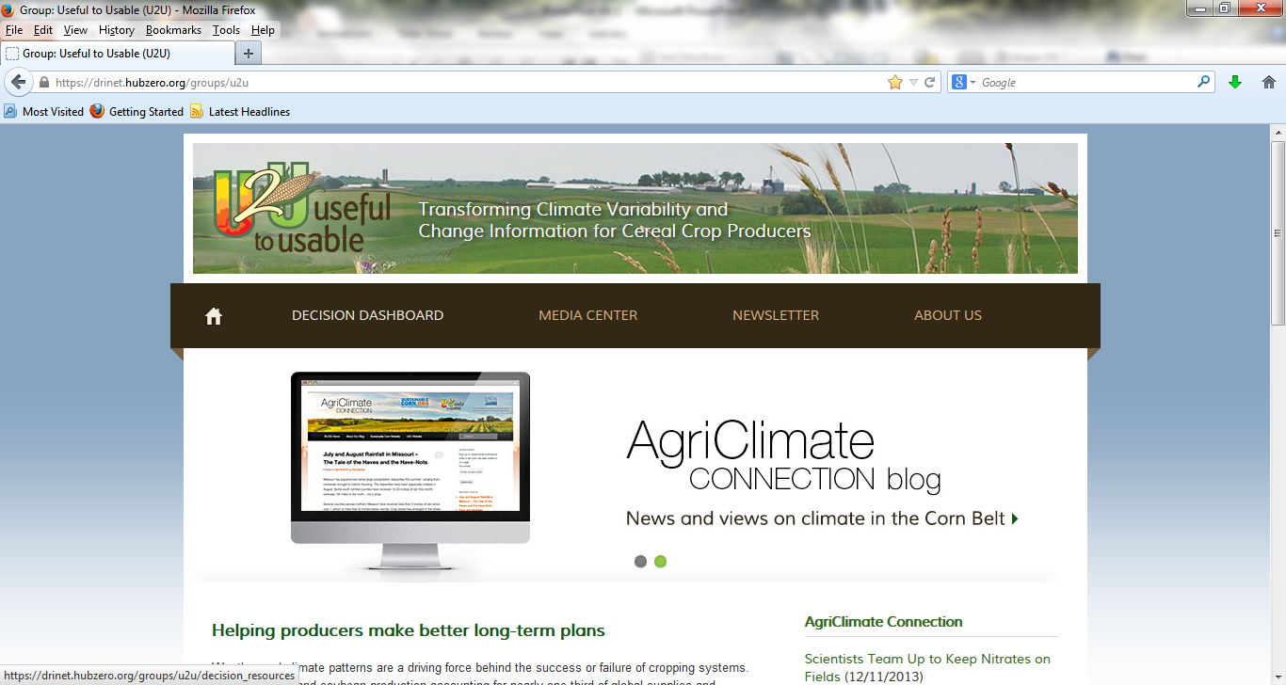
Irrigation Investment Calculator
Meeting Name
Location
Date
Presenter
University
email@somewhere.edu
Notes:
Welcome to this webinar to introduce the newest decision support tool from the Useful to Usable project.

Slide 2

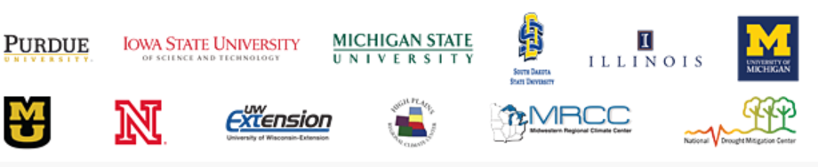
A Little Bit about U2U
Our goal is to help producers make better long-term plans on what, when and where to plant, and also how to manage crops for maximum yields and minimum environmental damage.
Notes:
Slide starts with graphic of university/institution logos, click to show 2013 team photo (putting faces to universities/institutions), click to reveal USDA-NIFA logo (point out funding source), then click to reveal overarching goal of project.

Slide 3
www.AgClimate4U.org
Notes:
Introduce the AgClimate4U.org website. Highlight “Decision Dashboard” for this and other decision support tool links, “Newsletter” for current updates, and “AgriClimate Connection Blog” for quick news/information
.

Slide 4
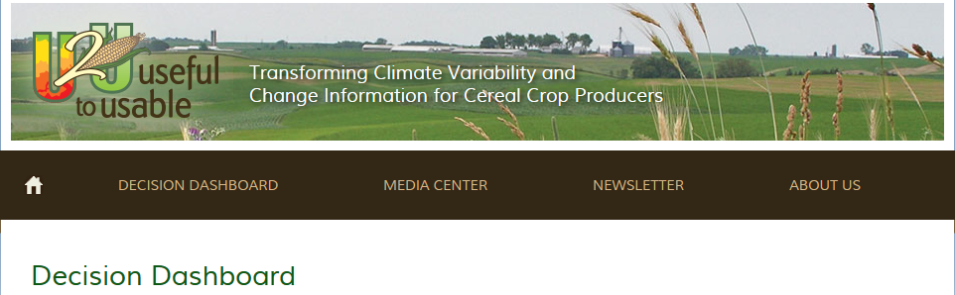
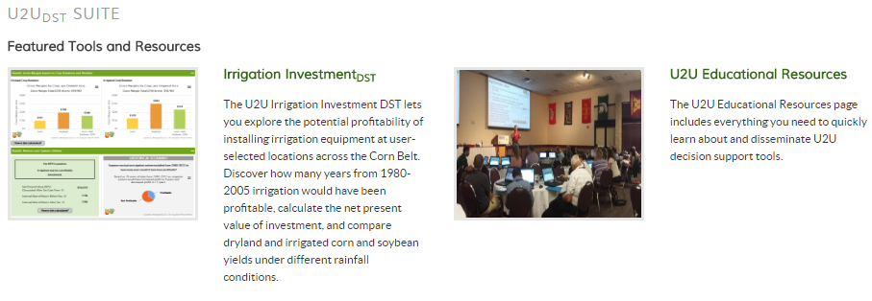
Decision Dashboard
Notes:
I like to point out that the Decision Dashboard has not only our decision support tools, but also links to other decision support tools, the latest reports from national/regional climate information centers, and weather/climate graphics for the Corn Belt.

Slide 5
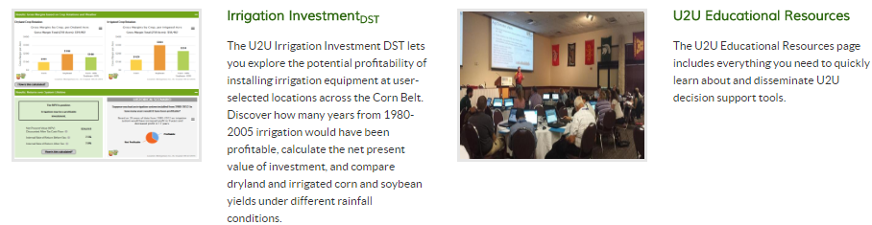
Decision Support Tools
Notes:
Shows participants the links to all of our decision support tools, while highlighting the one to be covered during the presentation.

Slide 6
This tool can help you:
Combine climate and crop model
data with customized cost and
loan information
Determine if irrigation may be profitable for your location
Understand financial performance of changing your corn/soybean rotation with and without irrigation
Explore irrigation investment potential throughout the Corn Belt

Slide 7
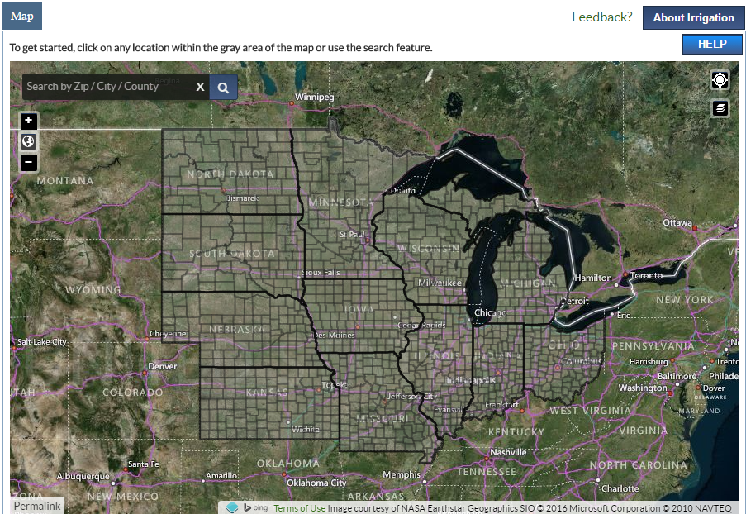
Pick Your Location
Notes:
Several ways to get started: Users can click on the map to select their county or type in their zip code, county, or a city.

Slide 8
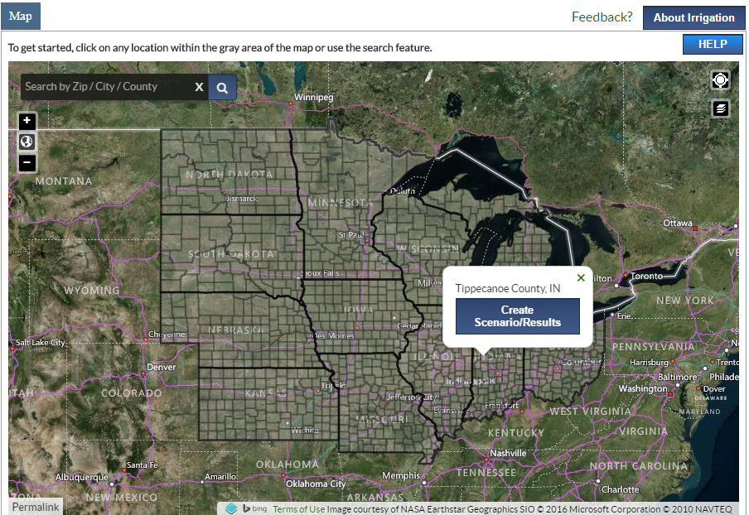
For Example:
Notes:
Once the user has found the county they want, they will need to click the “Create Scenario/Results” button to pull the data and information. Once the user does that…

Slide 9
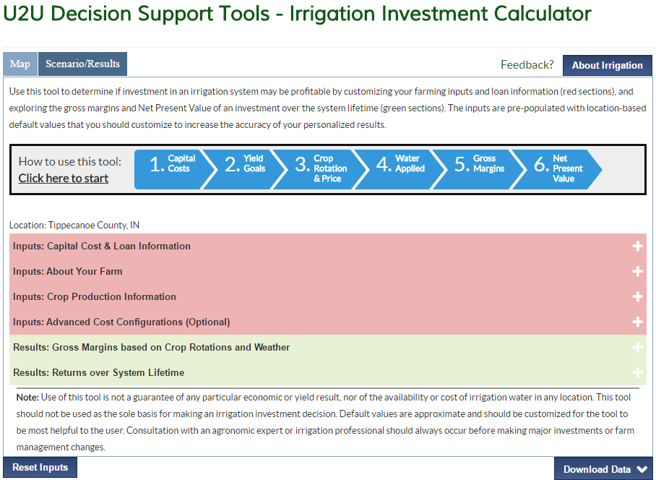
Irrigation Tool Orientation
Notes:
The Scenario/Results tab includes step by step instructions/guide to walk you through the process of entering parameters and customizing the output for the user-selected location on the map.
consists of several expandable subsections
“About Irrigation” links to the User Guide and documentation of the methods and sources used in the tool.
The red sub-sections are inputs that can be customized and the green sub-sections are results from the tool. Sub-sections can be expanded or minimized while working with the tool.

Slide 10
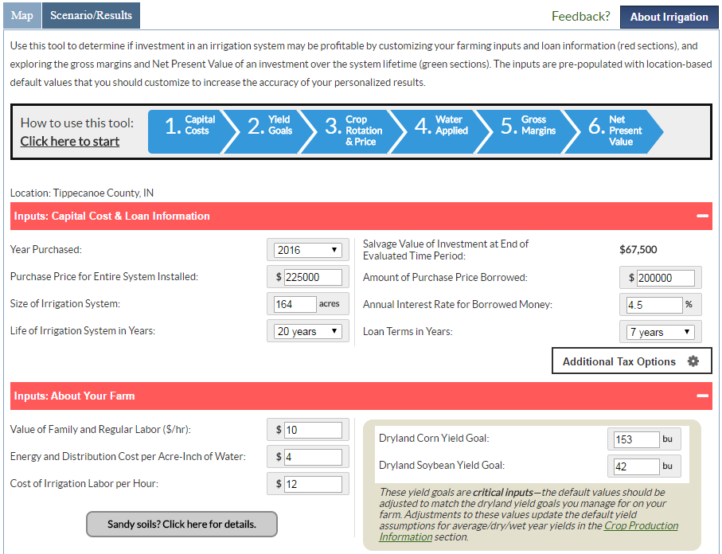
Investment and farm inputs
Notes:
Users enter the basic capital investment details for the size of system and the amount, term and interest rate of any loan to finance the investment. Detailed additional options pertaining to taxes can also be configured by selecting “Additional Tax Options.”
Farm specific irrigation input costs and dryland/unirrigated yield goals are crucial to getting results that are most relevant to your farm.

Slide 11
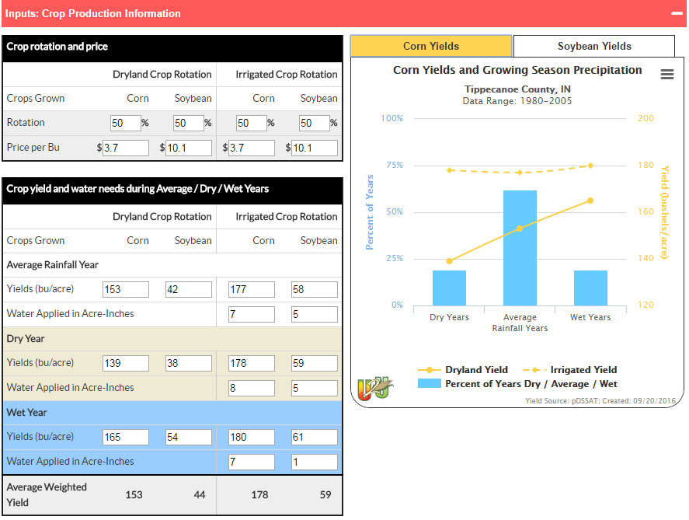
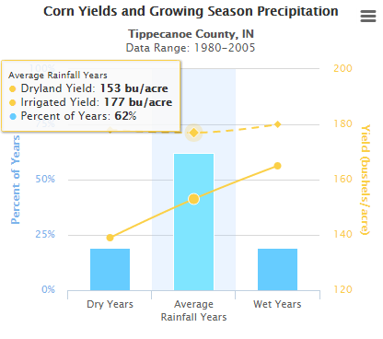
Inputs: Crop Production Info
Notes:
Very important crop production inputs are contained in this section of the tool.
The share of each crop—corn and soybeans—in the rotation can be specified for dryland and irrigated production and the price per bushel for each crop can also be adjusted.
If the different dryland and irrigated yields and irrigation water amounts for each type of weather year are known, these can be customized also. The default yields values are based on historic simulations, and you customize these for your farm all of the calculations will be adjusted based on the changes you make.
Weather years are classified as dry/average/wet based on the Standardized Precipitation Evapostranspiration Index (SPEI) which is consistent with the more familiar Palmer Drought Severity Index that is widely reported throughout the growing season for each area of the country.
The graphs on the right for both corn and soy depict the yield information on the left and the percentage of years between 1980-2005 that were dry/average/wet for the selected location.

Slide 12
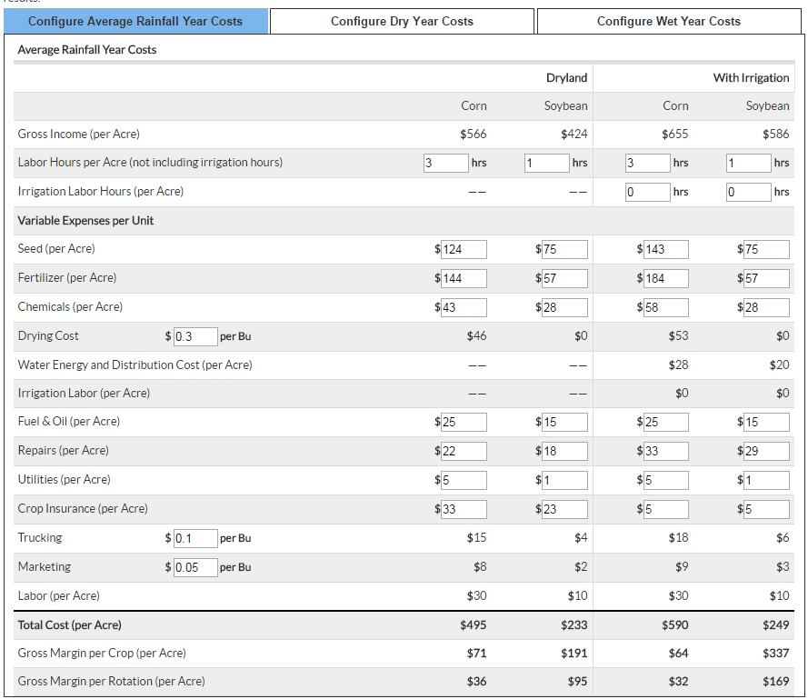
Advanced Inputs: Costs
Notes:
There are very detailed input costs that can be adjusted for your farm operation, and these can be entered differently for dry/average/wet weather years.
At the bottom are the total costs for dryland and irrigated conditions by crop, and the gross margins by crop and by crop+rotation share.

Slide 13
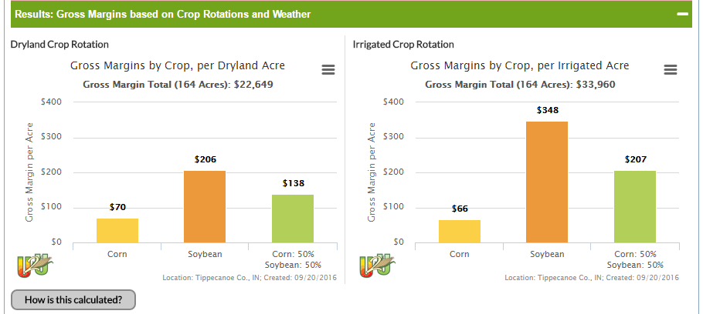
Results: Gross Margins
Notes:
The first results section graphically reports the calculated Gross margins for each crop and the rotation shares of the crops, for both dryland and irrigated production.
Note that the model that supplied the default yield values assumes a strong soybean yield response to irrigation that may or may not be reasonable in a specific area. This is another reason why users should customize some of the most important variables to fit their operation/area.
The “How is it calculated” button takes the user to the details about the gross margin calculations on the “About Irrigation” page.
The smaller three line graphic in the upper right corner of each graphical output can be clicked to save the graph/figure in different file formats.

Slide 14
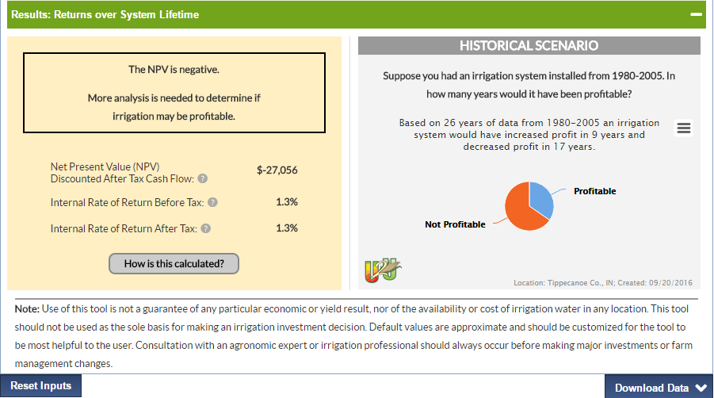
Results:
Returns over System Lifetime
Notes:
The final results section summarizes the investment calculations, providing the calculated Net Present Value (NPV) and Internal Rate of Return (IRR). The box on the left hand side is shaded light a stoplight—red, yellow or green—based on the NPV and IRR results calculated based on the overall interpretation of the results. The second panel is a pie chart showing the number of years when (not ) having irrigation would be (worse) better than not having (having) irrigation.
There is a “Download Data” button in the lower right corner that allows the user to download the calculated results and investment calculation details in a table for later reference or further analysis.

Slide 15
Thank you for your time!
Any questions?
Educators and presenters, you can find the latest version of slides for this decision tool (and all the other U2U tools and information) at: https://mygeohub.org/groups/u2u/kit
Notes:
Well, that’s the tour of the decision support tool. Thanks.
These slides, the User Guide for the tool, and additional resources are all contained on “Educational Resources” link (URL in the slide) from the “Decision Dashboard” page on the U2U website.

