Slide 1
Prototyping your tools on DRINET!
Carol Song
Sr. Research Scientist
Rosen Center for Advanced Computing
carolxsong@purdue.edu
Thanks to M. McLennan for the Rappture slides!

Slide 2
What is a HUB
A hub is a web based collaboration environment built on many open source packages.
Provides interactive online tools, content hosting, learning, collaboration, and community building capabilities.
Apache web server
Joomla content management system
MySQL database (storing content, stats, etc)
LDAP for authentication
PHP web scripting

Slide 3
Example HUBs
The very original http://nanohub.org
Many other hubs listed in http://hubzero.org “hubs to watch”
Note: Workshop on HUBzero, April 13-14, Indianapolis
Environmental research related:
http://drinet.hubzero.org

Slide 4
Main features in a HUB
Online simulation tools
User contributed materials
Tools
Online presentation, learning modules, podcasts
Course related materials (assignments, projects, lectures)
Datasets (being developed by a couple HUBs)
Usage statistics
User reviews, rating, tagging, profile
Citations
Groups (wiki, forum)
Support tools (ticket system, feedback, Q&A, knowledgebase, poll…)

Slide 5
Developing tools in a hub
Tools delivered through a web browser with
graphical user interfaces
Interactive
Visualization
Any tool that already has a GUI can be deployed into a hub
VNC technology (virtual network computing)
Legacy tools can be wrapped using Rappture
GUI generation
Rappture comes in a hub

Slide 6
Take a look at some tools
Nanohub.org
DRINET
Workspace

Slide 7
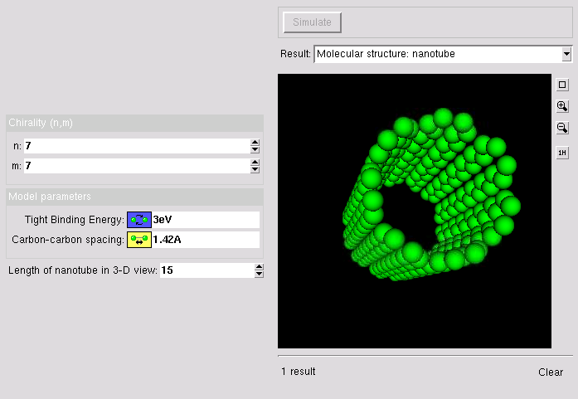
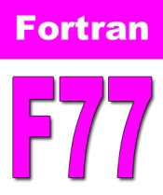
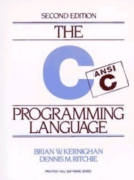
What is Rappture?
Rappture
=
Simulation
Code
Rapid Application Infrastructure
Created by NCN in Nov 2004
Open Source (rappture.org)
Create standard desktop apps
Works with your favorite
programming language
Scientist

Slide 8
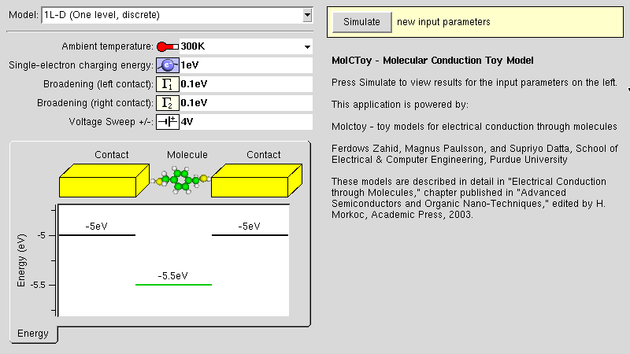
How does it work?
description of tool, including inputs and outputs
<XML>
tool.xml
executable
Rappture GUI
Produces the user interface
automatically!

Slide 9
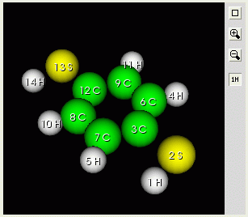
Focus on tool.xml
Same objects act as either inputs or outputs*
*not always true, but should be
description of tool, including inputs and outputs
<XML>
<?xml version="1.0"?>
<run>
<tool>
<about>This is my tool.</about>
…
</tool>
<input>
</input>
<output>
</output>
</run>
tool.xml
executable
Rappture GUI
Produces the user interface
automatically!

Slide 10
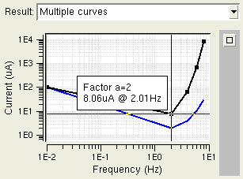
Similar structure
All objects have an <about> section with <label> and <description>
<number id="temperature">
<about>
<label>Ambient temperature</label>
<description>This is the temperature in the environment around the device.</description>
</about>
…
</number>
This is the temperature in the environment around the device.
This is an example that has multiple curves.
<curve id=“multi">
<about>
<label>Multiple curves</label>
<description>This is an example that has multiple curves.</description>
</about>
…
</curve>

Slide 11
<number>
Real number with optional units
<number id="vsweep">
<about>
<label>Voltage Sweep +/-</label>
<description>This determines the voltage sweep used to obtain results from the model.</description>
<icon>
R0lGODlhGgASAKEBAAAAAP///////////yH+FUNyZWF0ZWQgd2l0aCBUaGUgR0lNUAAh+QQBCgAB
ACwAAAAAGgASAAACLoyPqcvtD8CRj8VZrYw8h/tRn2eA4Eiaosa1qttC1EmW81qrtbYvdG8DCodE
RQEAOw==
</icon>
</about>
<units>V</units>
<min>0V</min>
<max>10V</max>
<color>purple</color>
<default>4V</default>
</number>
Optional base-64
(mime) encoded
GIF image for icon
Optional system of units
Constrain input values
Optional color is
used if min/max
values are set
Start with this by default

Slide 12
<number>
Real number with optional units
<number id="temperature">
<about>
<label>Ambient temperature</label>
<description>This is the temperature in the environment around the device.</description>
</about>
<units>K</units>
<min>50K</min>
<max>1000K</max>
<default>300K</default>
<preset>
<value>300K</value>
<label>300K (room temperature)</label>
</preset>
<preset>
<value>77K</value>
<label>77K (liquid nitrogen)</label>
</preset>
</number>
Temperature gauge
appears if units are
for temperature
Presets create a
little drop-down menu
of common choices

Slide 13
<integer>
Like a <number>, but accepts only integer values
<integer id="points">
<about>
<label>Grid points</label>
<description>Number of nodes used in the simulation mesh.</description>
</about>
<min>10</min>
<max>1000</max>
<default>100</default>
</integer>
Buttons to adjust
value up/down
Constrain input values
Start with this by default

Slide 14
<boolean>
Simple on/off value
<boolean id="iimodel">
<about>
<label>Impact Ionization Model</label>
<description>Used to enable/disable the effects of impact ionization on the mobility model.</description>
</about>
<default>yes</default>
</boolean>
Start with this by default

Slide 15
<choice>
Set of mutually exclusive options
<choice id="stats">
<about>
<label>Carrier Statistics</label>
<description>Determines the model…</description>
</about>
<option>
<about>
<label>Boltzmann</label>
<description>From the Boltzmann transport equation</description>
</about>
<value>bte</value>
</option>
…
<default>Boltzmann</default>
</choice>
Optional. If specified, then report this value when this option is selected
This by default

Slide 16
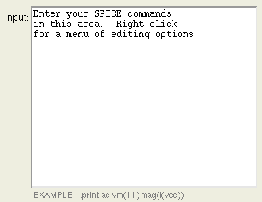
<string>
Quick line of text, or even a whole file! Binary files too.
<string id="title">
<about>
<label>Title</label>
<description>Title for all plots.</description>
</about>
<default>untitled</default>
</string>
<string id="indeck">
<about>
<label>Input</label>
<description>This is the control file for the program.</description>
<hints>EXAMPLE: .print ac vm(11)</hints>
</about>
<size>40x10</size>
<default>Enter your SPICE commands here.</default>
</string>
width x height
in characters

Slide 17
<image>
Data for image processing
<image>
<current>R0lGODlhtAA8APcAAFeBu////0VurKW829Ld7YSjQ1
8Y+r0rHE31aAus3Y6VJ5sEpysEdvrXeVwlV+uVB6tVZ/uEhwrlV/u
tkZol5yy0092q0dqmVV+t053tElxr0VmlEVnlU92qlR8tFN7sk12s
...
</current>
</image>
GIF, JPEG, or PNG in base-64 format
Can use as a decoration on the input side, but there are better ways to do that now.

Slide 18
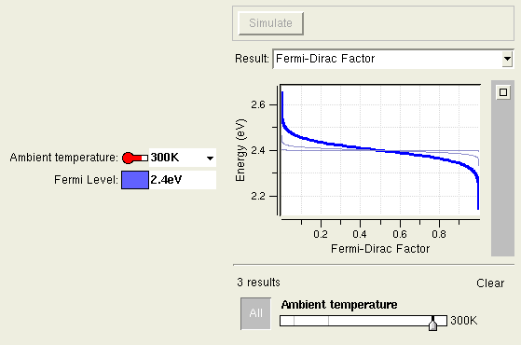
Better User Interfaces
Temperature gauge
Zoom in/out
Validation of inputs
Units conversion
Adjust knob to compare simulations

Slide 19
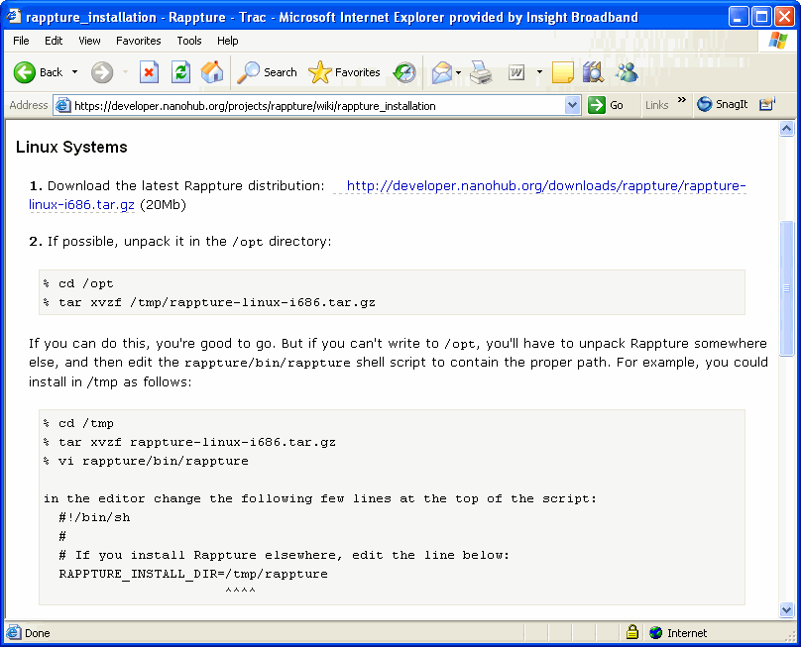
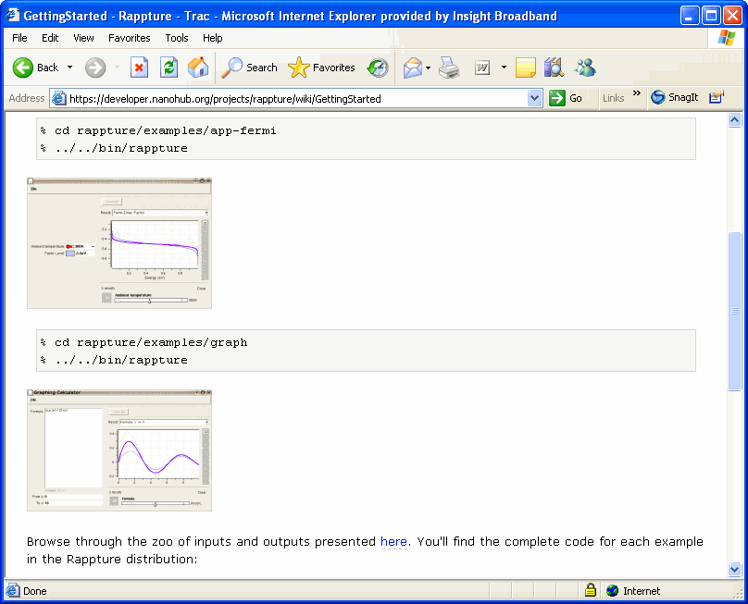
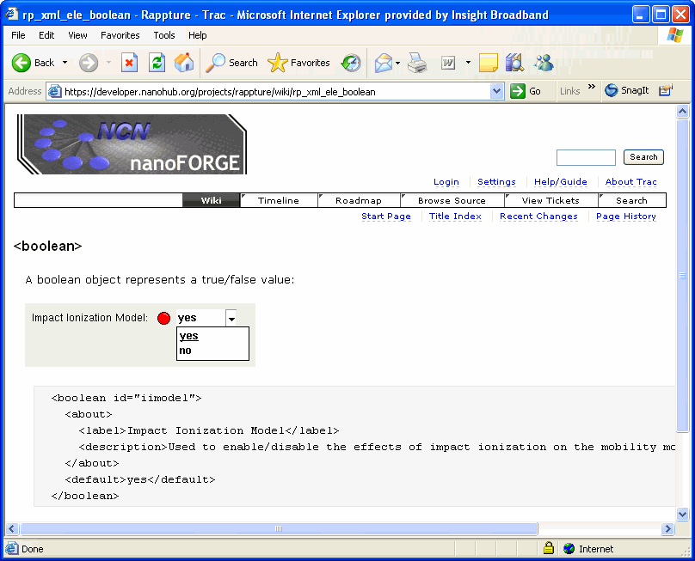
More Information
http://rappture.org
What is Rappture?
Getting Started
Documentation
Downloads
Examples:
/apps/rappture/current/examples
In your workspace, type: /apps/rappture/copy_rappture_examples cd rappture_examples ls
Mailing list:
Post: rappture@lists.nanohub.org
Subscribe: rappture-request@lists.nanohub.org with subject subscribe

Slide 20
Information
Introducing the Rappture Toolkit
http://hubzero.org/resources/45
More Rappture objects
http://hubzero.org/resources/48
More presentations on tool development
http://hubzero.org/resources/tooldev
HUBzero information
http://hubzero.org

Slide 21
What to do next
If you want to experiment and be hands-on, register at http://drinet.hubzero.org for a free account.
Feel free to ask questions – we have several people in the group that can help.
Collaborate!

